Slide 1
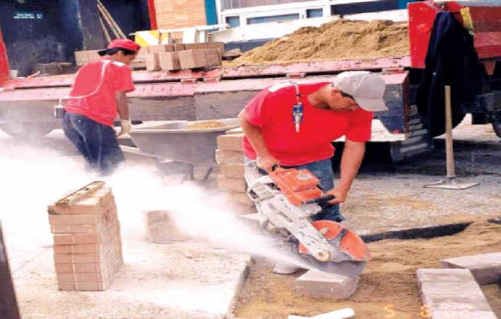
Silica: Regulatory Update and Outreach Resources
August 17, 2016

Slide 2
Final Rule Published on March 25, 2016

Slide 3
Reasons for the Rule
Current permissible exposure limits (PELs) are formulas that many find hard to understand
Construction/shipyard PELs are obsolete particle count limits
General industry formula PEL is about equal to 100 µg/m³; construction/shipyard formulas are about 250 µg/m³

Slide 4
Most Important Reason for the Rule
Current PELs do not adequately protect workers
Extensive epidemiologic evidence that lung cancer and silicosis occur at exposure levels below 100 µg/m³

Slide 5
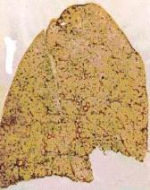
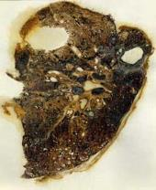
Exposure and Health Risks
Exposure to respirable crystalline silica has been linked to:
  Silicosis;
  Lung cancer;
  Chronic obstructive pulmonary disease; and
  Kidney disease
Healthy Lung
Silicotic Lung

Slide 6
Health Benefits
OSHA estimates that once the effects of the rule are fully realized, it will prevent:
More than 600 deaths per year
  Lung cancer: 124
  Silicosis and other non-cancer
  lung diseases: 325
  End-stage kidney disease: 193
More than 900 new silicosis cases per year

Slide 7
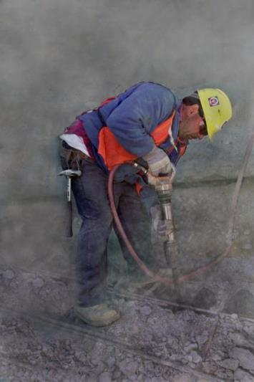
Scope of Coverage
Three forms of silica: quartz, cristobalite and tridymite
Exposures from jackhammering, chipping, cutting, sawing, drilling, milling, grinding, air lancing, sanding, and crushing of concrete, brick, block, rock, and stone products

Slide 8
Industries and Operations with Exposures
Construction Glass manufacturing Pottery products Structural clay products Concrete products Foundries Dental laboratories Paintings and coatings Jewelry production Refractory products Asphalt products | Landscaping Ready-mix concrete Cut stone and stone products Abrasive blasting in: Maritime work Construction General industry Refractory furnace installation and repair Railroads Hydraulic fracturing for gas and oil

Slide 9
Workers and Industries Affected
2.3 million workers:
  Construction: 2 million
  GI/Maritime: 300,000
676,000 establishments
  Construction: 600,000
  GI/Maritime: 76,000

Slide 10
Respirable Crystalline Silica Rule
Two standards:
  One for general industry and maritime
  One for construction
Similar to other OSHA health standards and ASTM consensus standards

Slide 11
Construction - Scope
All occupational exposures to respirable crystalline silica are covered, unless employee exposure will remain below 25 μg/m³ as an 8-hr TWA under any foreseeable conditions.

Slide 12
Construction
(a) Scope
(b) Definitions
(c) Specified exposure control methods
OR
(d) Alternative exposure control methods
  PEL
  Exposure Assessment
  Methods of Compliance
(e) Respiratory protection
(f) Housekeeping
(g) Written exposure control plan
(h) Medical surveillance
(i) Communication of silica hazards
(j) Recordkeeping
(k) Dates

Slide 13
Construction -
Specified Exposure Control Methods
Table 1 in the construction standard matches 18 tasks with effective dust control methods and, in some cases, respirator requirements.
Employers that fully and properly implement controls on Table 1 do not have to:
  Comply with the PEL
  Conduct exposure assessments for employees engaged in those tasks

Slide 14
Construction
(d) Alternative exposure control methods
  PEL
    50ug/m³
  Exposure Assessment
    Objective Data
    Scheduled Monitoring
      Initial <25ug/m³ ⁽AL) discontinue monitoring
      If = or > AL but <PEL monitor within 6 months
      If >PEL monitor within 3 months
      Non “initial monitoring” within 6 months if 2 consecutive measurements > 7 days apart are below AL discontinue monitoring
    Reassessment
      Required if changes made in production, process, control equipment, personnel, or work practices may result in new or additional exposure >AL

Slide 15
Construction
(d) Alternative exposure control methods
    Sample analysis in accordance with Appendix A (6/23/18)
    Notify workers of results and if > PEL how exposure is being reduced
    Provide employees opportunity to observe monitoring
  Methods of Compliance
    Engineering and work practice controls required to reduce exposure to at or < PEL unless infeasible then lowest level possible
    Abrasive blasting follow this standard and 1926.57 (ventilation) when applicable

Slide 16
Construction
(e) Respiratory protection
  Where specified in Table 1 OR
  Where otherwise required
    Exposures >PEL
    Where controls are not feasible
    Where feasible controls are not sufficient to get exposure <PEL
  Respiratory Protection Program required (1910.134)
  If following Table 1
    134(d)(1)(iii) for assessing hazards not required
    134(d)(3) for Assigned Protection Factor not required

Slide 17
Construction
(f) Housekeeping
No dry sweeping where it can contribute to exposure
HEPA Vacuum
No compressed air cleaining (i.e., air lancing) unless with effective ventilation or if no alternative method is feasible

Slide 18
Construction
(g) Written exposure control plan
  The plan must describe:
    Tasks involving exposure to respirable crystalline silica
    Engineering controls, work practices, and respiratory protection for each task
    Housekeeping measures used to limit exposure
    Procedures used to restrict access, when necessary to limit exposures

Slide 19
Construction
(h) Medical surveillance
  Employers must offer medical examinations to workers:
  Who will be required to wear a respirator under the standard for 30 or more days a year.
  Employers must offer examinations every three years to workers who continue to be exposed above the trigger
  Exam includes medical and work history, physical exam, chest X-ray, and pulmonary function test (TB test on initial exam only)

Slide 20
Construction
(i) Communication of silica hazards
Comply with the Hazard Communication Standard
  Hazcom program
  Labeling
  SDSs
  Information and training
    Health hazards
    Tasks that could expose
    Measures to protect employees from exposure (engineering controls, work practices, PPE)
    Contents of the standard (plus copy)
    ID of competent person
    Medical surveillance program description and purpose

Slide 21
Construction
(j) Recordkeeping
Air monitoring data
  Date
  S&A Methods
  # & duration
  ID of lab
  PPE type
  SS #, job classification of all employees represented by monitoring
  Keep in accordance with 1910.1020(30 years)

Slide 22
Construction
(j) Recordkeeping
Objective data
  ID of silica containing material
  Source of objective data
  Testing protocol and results of testing
  Description of the process, task or activity on which objective data was bases
  Other data relevant to the process or exposures on which the objective data was based (30 years)

Slide 23
Construction
(j) Recordkeeping
Medical Surveillance
  For each employee
    Name and SS#
    Copy of PLHCPs and specialists written opinions
    Copy of info provided to PLHCPs
    Keep for duration of employment + 30 years
  (k) Dates
    Employers must comply with all requirements (except methods of sample analysis) by June 23, 2017
    Compliance with methods of sample analysis required by June 23, 2018

Slide 24
Example of Table 1 Entry
Equipment / Task | Engineering and Work Practice Control Methods | Required Respiratory Protection and Minimum APF
 |  | ≤ 4 hr/shift | > 4 hr/shift
Handheld power saws (any blade diameter) | Use saw equipped with integrated water delivery system that continuously feeds water to the blade. Operate and maintain tool in accordance with manufacturers’ instruction to minimize dust When used outdoors When used indoors or in an enclosed area | None APF 10 | APF 10 APF 10

Slide 25
Example of Table 1 Entry
Equipment / Task | Engineering and Work Practice Control Methods | Required Respiratory Protection and Minimum APF
 |  | ≤ 4 hr/shift | > 4 hr/shift
Stationary masonry saws | Use saw equipped with integrated water delivery system that continuously feeds water to the blade. Operate and maintain tool in accordance with manufacturer’s instructions to minimize dust emissions. | None | None

Slide 26
Example of Table 1 Entry
Equipment / Task | Engineering and Work Practice Control Methods | Required Respiratory Protection and Minimum APF
 |  | ≤ 4 hr/shift | > 4 hr/shift
Vehicle-mounted drilling rigs for rock and concrete | Use dust collection system with close capture hood or shroud around drill bit with a low-flow water spray to wet the dust at the discharge point from the dust collector. OR Operate from within an enclosed cab and use water for dust suppression on drill bit. | None None | None None

Slide 27
List of Table 1 Entries
Stationary masonry saws
Handheld power saws
Handheld power saws for fiber cement board
Walk-behind saws
Drivable saws
Rig-mounted core saws or drills
Handheld and stand-mounted drills
Dowel drilling rigs for concrete
Vehicle-mounted drilling rigs for rock and concrete
Jackhammers and handheld powered chipping tools
Handheld grinders for mortar removal (tuckpointing)
Handheld grinders for other than mortar removal
Walk-behind milling machines and floor grinders
Small drivable milling machines
Large drivable milling machines
Crushing machines
Heavy equipment and utility vehicles to abrade or fracture silica materials
Heavy equipment and utility vehicles for grading and excavating

Slide 28
Fully and Properly Implementing Controls Specified on Table 1
Presence of controls is not sufficient.
Employers are required to ensure that:
  Controls are present and maintained
  Employees understand the proper use of those controls and use them accordingly

Slide 29
Employees Engaged in Table 1 Tasks
Employees are “engaged in the task” when operating the listed equipment, assisting with the task, or have some responsibility for the completion of the task
Employees are not “engaged in the task” if they are only in the vicinity of a task

Slide 30
Respiratory Protection Requirements on Table 1
Respirators required where exposures above the PEL are likely to persist despite full and proper implementation of the specified engineering and work practice controls
Where respirators required, must be used by all employees engaged in the task for entire duration of the task
Provisions specify how to determine when respirators are required for an employee engaged in more than one task

Slide 31
Construction –
Competent Person
Construction employers must designate a competent person to implement the written exposure control plan
Competent person is an individual capable of identifying existing and foreseeable respirable crystalline silica hazards, who has authorization to take prompt corrective measures
Makes frequent and regular inspection of job sites, materials, and equipment

Slide 32
Guidance and Outreach
Silica Rulemaking Webpage: www.osha.gov/silica
  Fact sheets
  FAQs
  Video
Appendix B – Medical Surveillance Guidelines
Coming soon after publication:
  Small Entity Compliance Guides

Slide 33
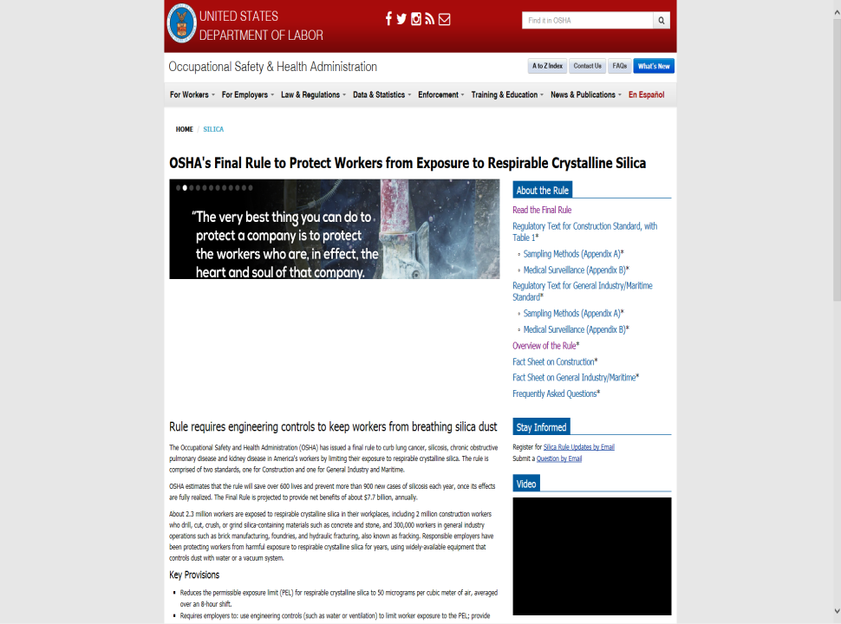

Slide 34
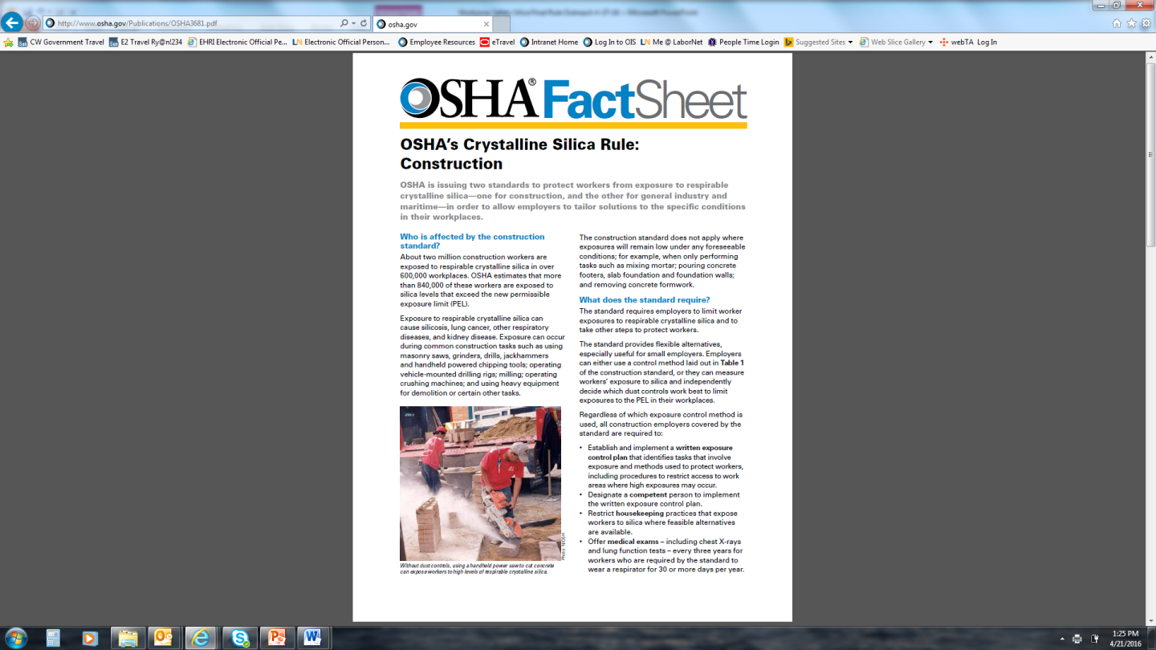

Slide 35
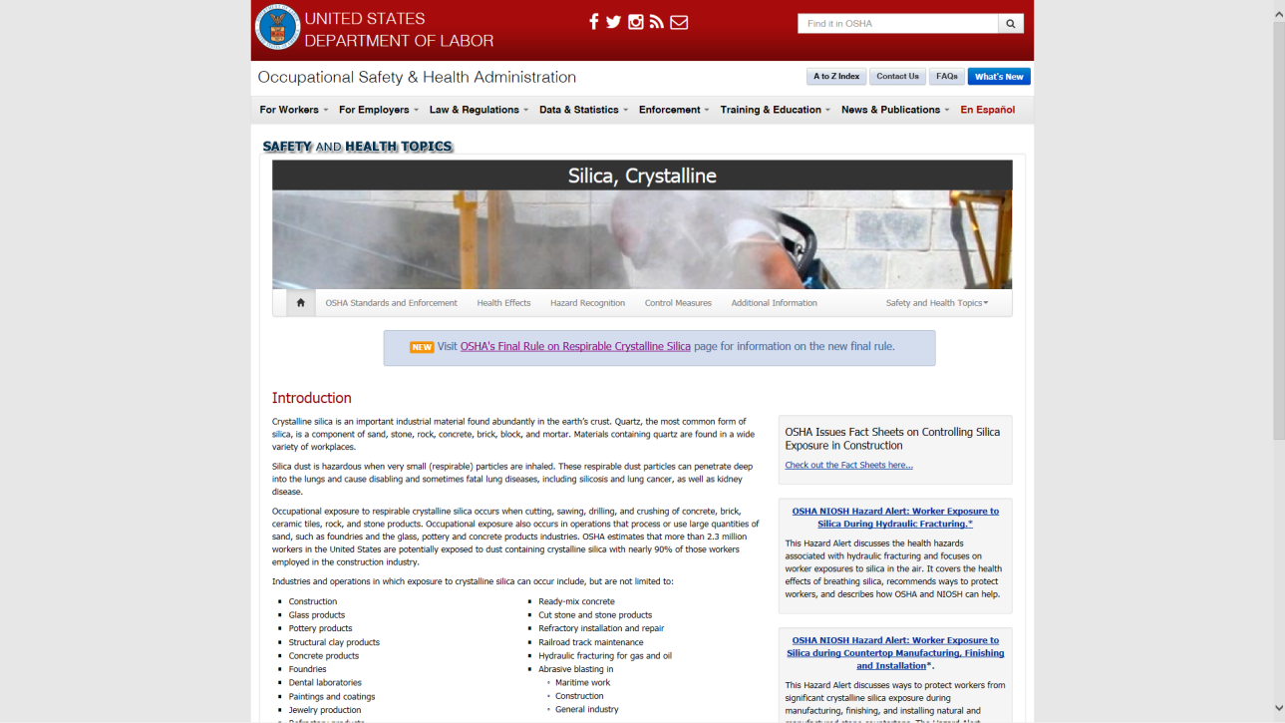

Slide 36
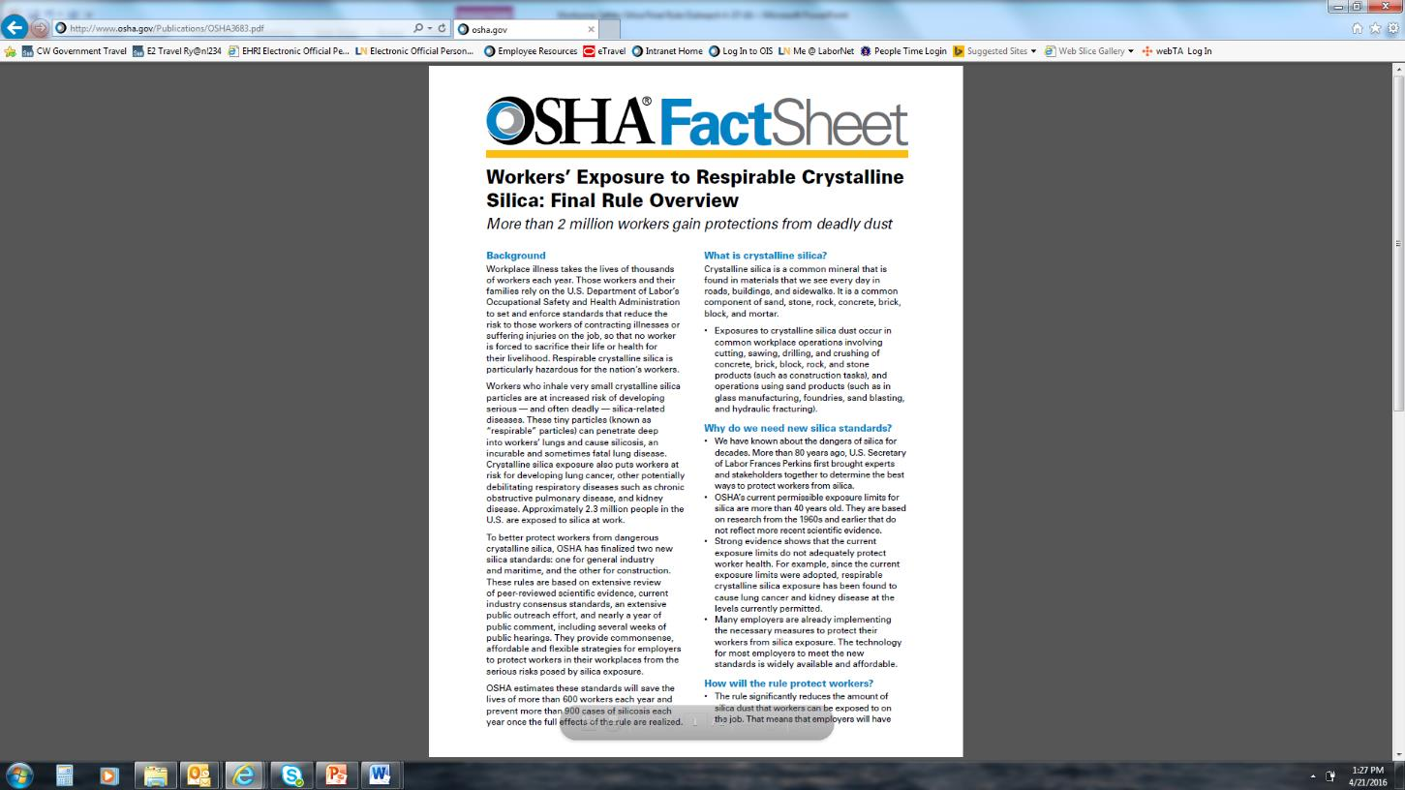

Slide 37
Silica-safe.org
(CPWR r2p)
www.silica-safe.org

Slide 38

Notes:
Designed as a one-stop resource for contractors, workers and other stakeholders, the website features information and tools to help identify silica hazards, understand the health risk, and easily find equipment and methods to control the dust.
A central feature of the site is the Create-A-Plan tool. This e-tool allows you to develop a job-specific plan for controlling silica exposures in just three easy steps, and includes options for identifying a material's silica content, determining the level of exposure, and finding available controls. As you make selections and enter information a plan tailored for your jobsite is automatically generated that you can save, print, email, and -- as an added benefit -- use as a toolbox talk on the job.
The Know the Hazard feature explains why silica is hazardous, the risk, health effects, and actions contractors and workers can take. The Training & Other Resources section provides ready access to silica-specific materials in a variety of formats including presentations, videos, hand-outs, and training guides. Examples of actions that contractors, manufacturers, workers, and researchers are already taking to address the hazard and control the dust can be found in the What's Working section, along with a way to share your successes and challenges. This new website also includes research findings, the latest silica news, and updates on regulatory efforts.

Slide 39
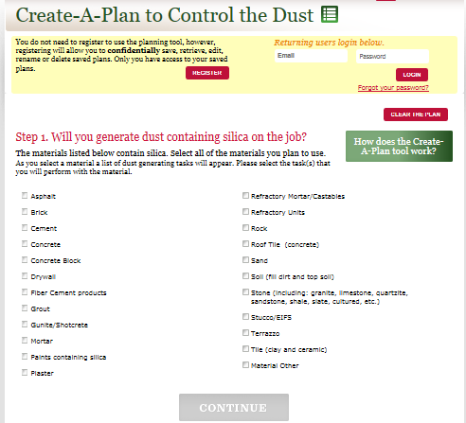

Slide 40


Slide 41
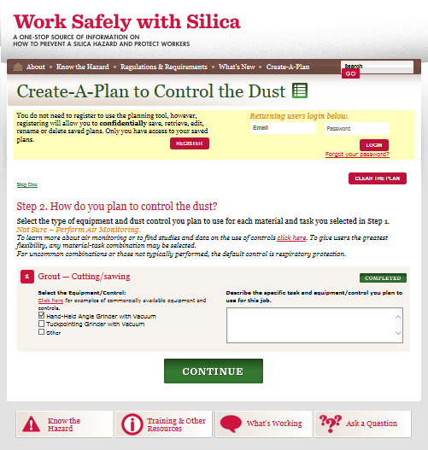

Slide 42
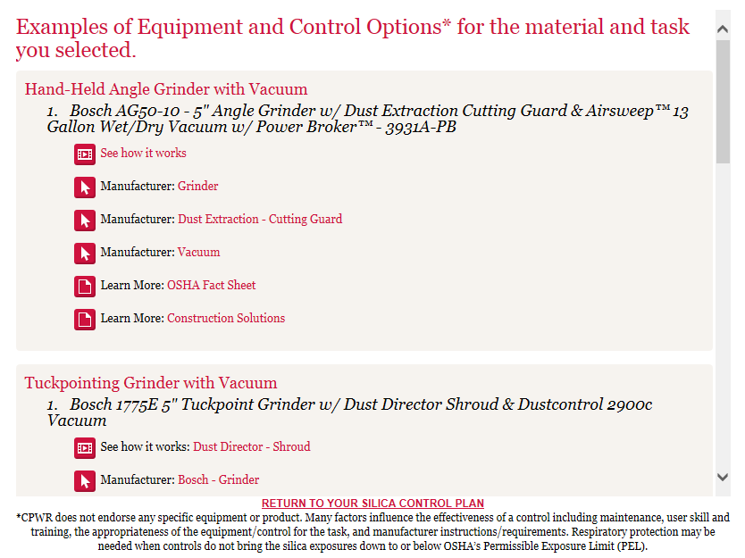



Slide 43
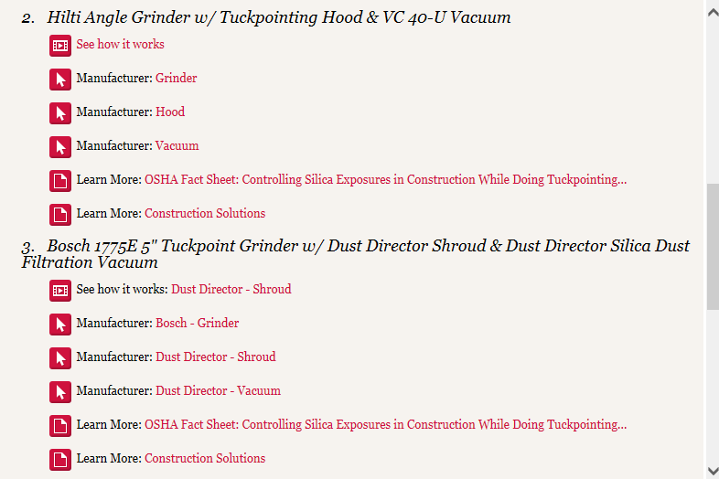

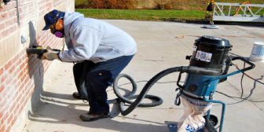

Slide 44
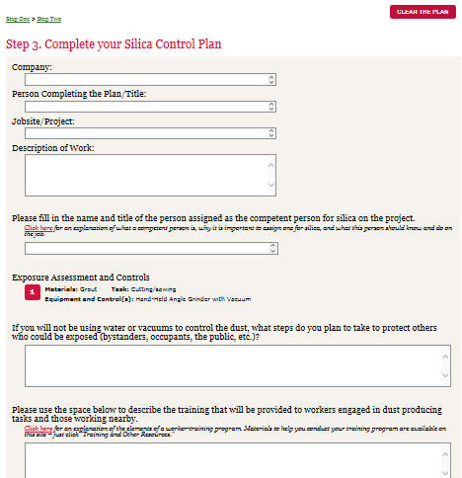

Slide 45
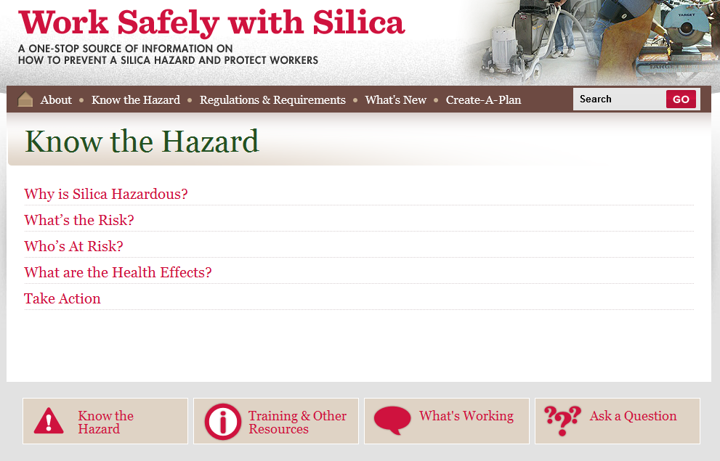

Slide 46
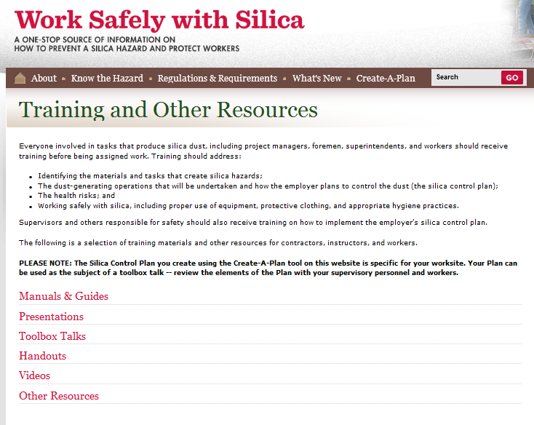

Slide 47
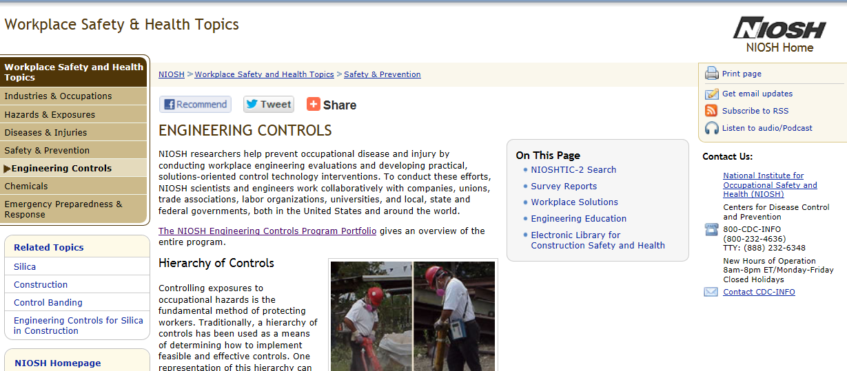

Slide 48
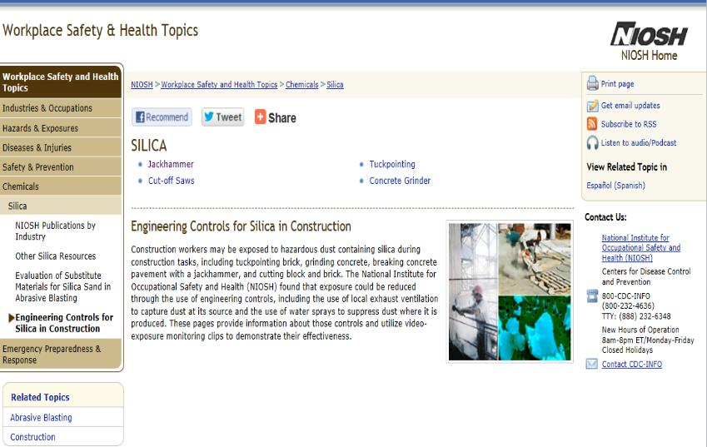

Slide 49
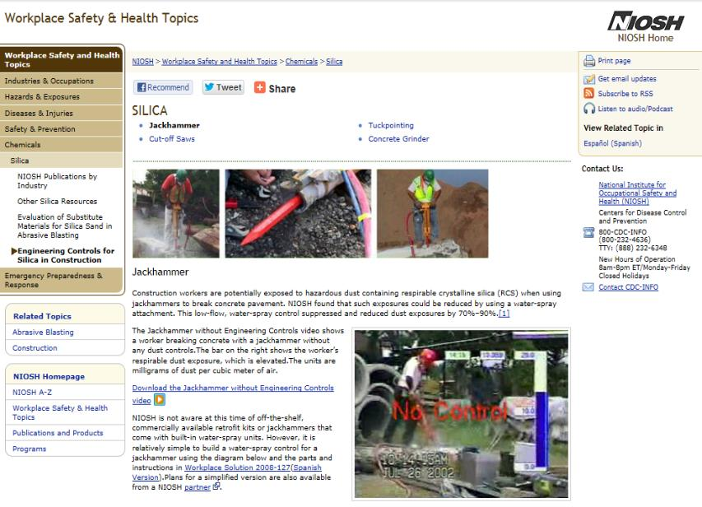
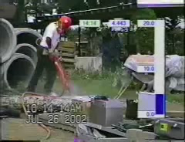

Slide 50
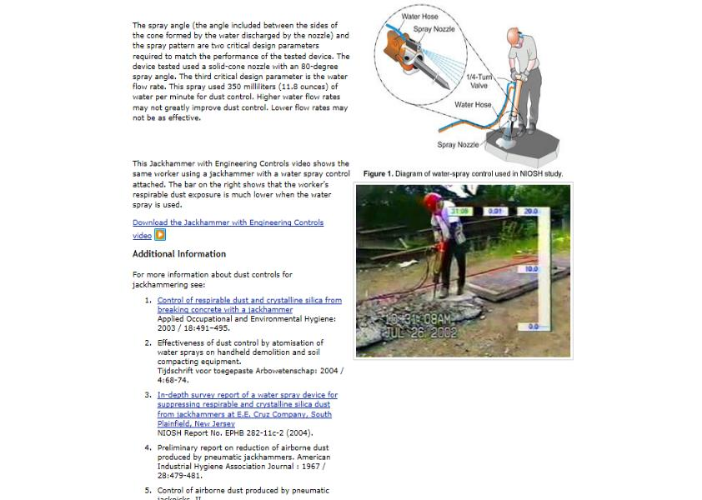
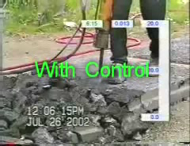

Slide 51
